Slide 1
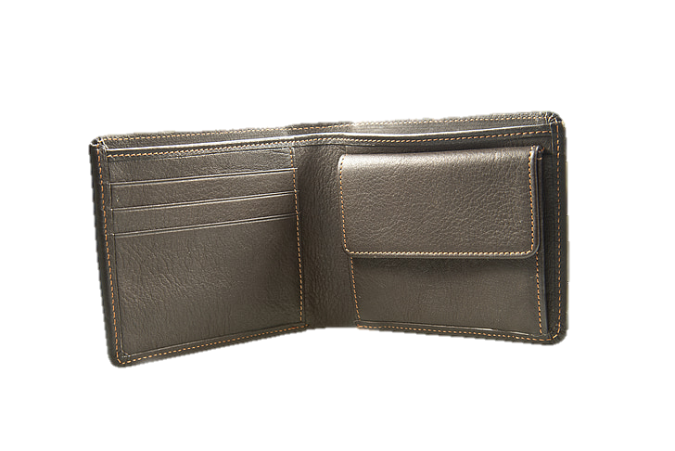

Slide 2


Slide 3






Slide 4


Wallet theft is a common issue worldwide, leaving victims feeling helpless and losing valuable items.
“What if the thief couldn’t get away so easily?”
The Solution: A wallet that fights back, making theft more inconvenient than ever.

Slide 5
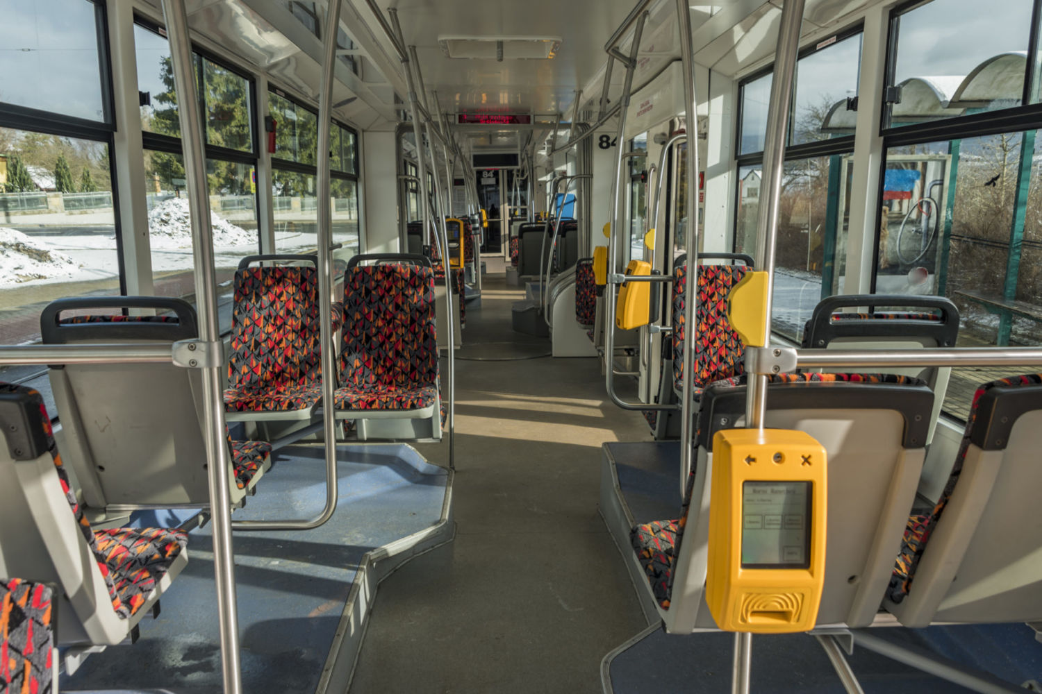
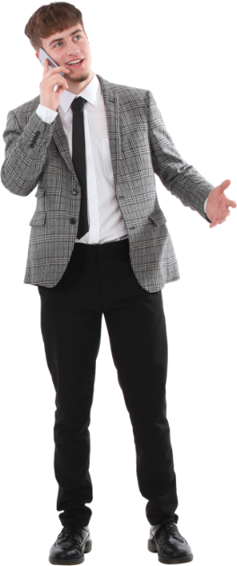
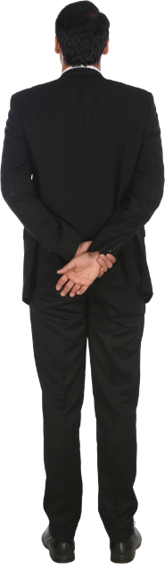

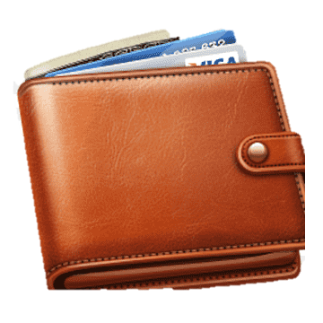


Slide 8
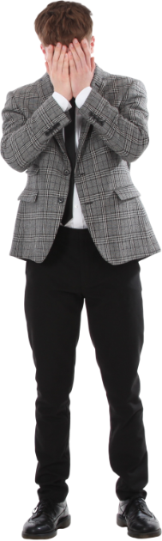

Slide 9



Slide 10


Slide 11



Slide 12


Slide 13

Professionals who carry important cards, cash, and IDs
Travelers concerned about pickpockets
Tech enthusiasts who love innovative gadgets

